Slide 1
A 24-bit Microprocessor
Youzhe Dou, Yulong Wang, and Howard Xu

Slide 2
System overview
Mode, timing, instruction cycle
JMP, BEQ, etc.
Control Unit
RAM
ALU
Register File
Not, and, or, xor, add, neg, sub
load, clear, shift

Slide 3
Computer instructions
00 000 00 00000000000000000
Instruction type
Register file
decoder
address
Mode

Slide 4
Computer instructions details
Instruction type:
00: register file operations (load, clear, shift)
10: ALU operations (add, sub, neg, ect)
Result is always saved to AC
11: control unit operations (JMP and BEQ)

Slide 5
Computer instructions details
ALU mode type:
000: AC = NOT(AC)
001: AC = AND (DR1, DR2)
010: AC = OR(DR1, DR2)
011: AC = XOR(DR1, DR2)
100: AC = ADD(DR1, DR2)
101: AC = NEG (two’s complement, DR2)
110: AC = SUB (DR1, DR2)

Slide 6
Computer instructions details
Register file mode type:
000: load
001: increment
010: left shift
011: right shift
100: clear
101: no operation

Slide 7
Instructions list
Instruction | Instruction type | First 5 bits of instruction code | Input data | Output destination
MOV | Register file | 00 000 | From address | DR1 or DR2
INC | Register file | 00 001 | - | DR1 or DR2
SHL | Register file | 00 010 | - | DR1 or DR2
CLR | Register file | 00 100 | DR1 or DR2 | -
ADD | ALU | 10 100 | - | AC
JMP | control | 11 001 | address | -
SNA | control | 11 000 | address | -

Slide 8
Instructions list
Instruction | Instruction type | First 5 bits of instruction code | Input data | Output destination
SUB | ALU | 10 110 | - | AC
XOR | ALU | 10 011 | - | AC
JMP | control | 11 001 | address | -
BEQ | control | 11 000 | address | -
NOP | - | 10 111 | - | -

Slide 9
Pseudo Code
Task: multiplication of two integers
Pseudo code for “shift and add” algorithm:
Load data1 into DR1
Load data2 into DR2
Copy DR2 into flag register
Clear DR2
Right shift flag register
If flag register pointer = 1 ->step 7, else -> step 8
Add DR1 and DR2
Left shift DR1
Copy AC to DR2
If flag register is empty -> end , else -> step 5
DR1 being shifted
DR2
If 1, add and shift
1001
X 1101
1001
0000
1001
1001
1110101

Slide 10
Translate pseudo code to ROM data
("000000000000000000000000"),--0
("000000000000000000000000"),--1
("000001000000000000000000"),--2--Copy data1 into DR1
("000001100000000000000000"),--3--Copy data2 into DR2
("111000000000000000000000"),--4--Copy DR2 into flag register
("000001100000000000000000"),--5--Clear DR2
("111010000000000000000110"),--6--right shift flag register
("111100000000000000000111"),--7--BEQ1 (skip if that bit is '0')
("101000000000000000001000"),--8--ADD DR1 DR2
("000101000000000000000000"),--9--left shift DR1
("110001100001010101010101"),--10--copy AC to DR2
("000000000000000000000000"),
("111110000001010101010101"),--11--BEQ2 (are all bits finished?): step 6 if 1, or end if 0

Slide 11
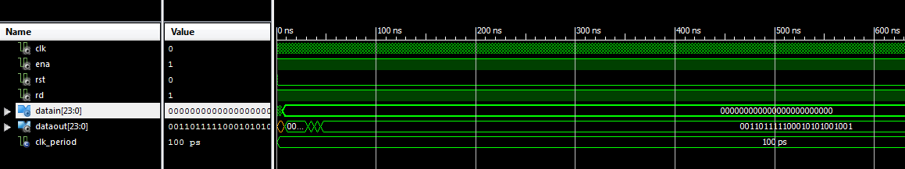
Simulation

Slide 12
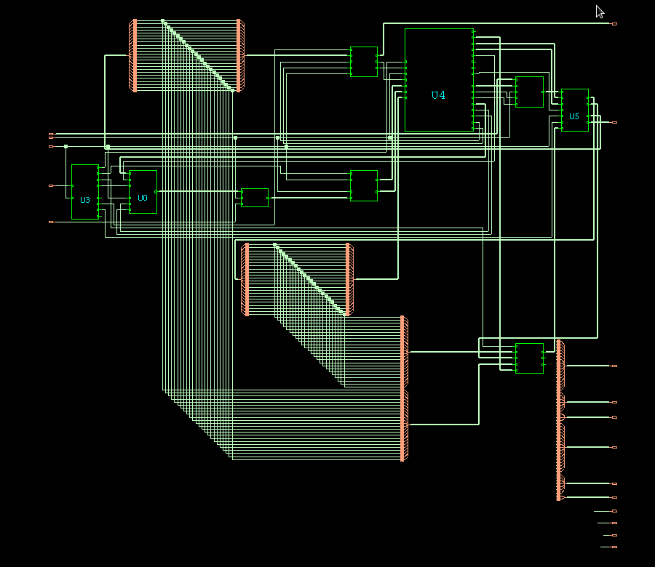
Schematic

Slide 13
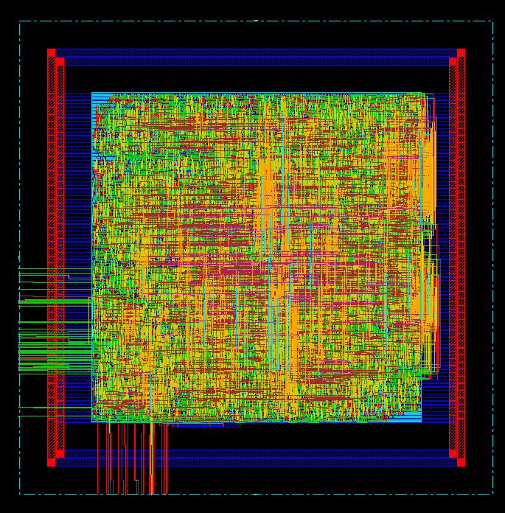
Layout

Slide 14
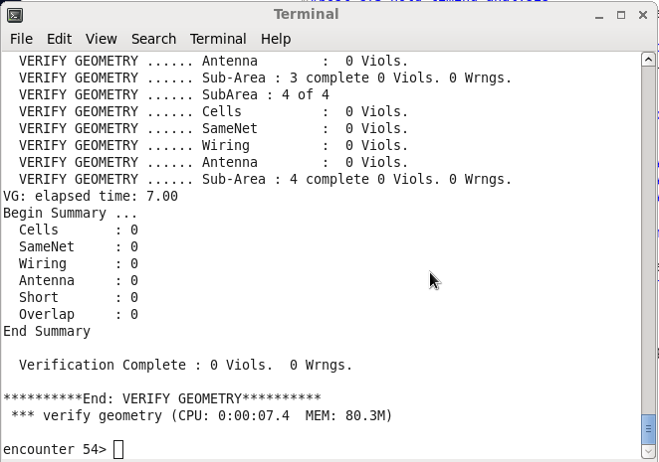
Geometry Check

Slide 15
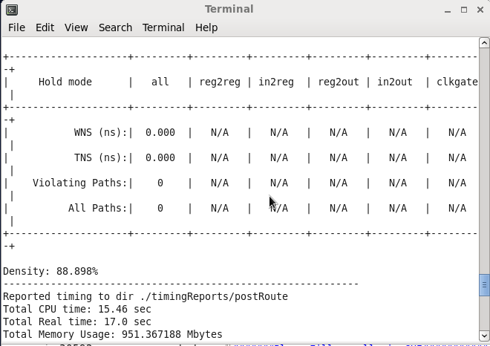
Density

Slide 16
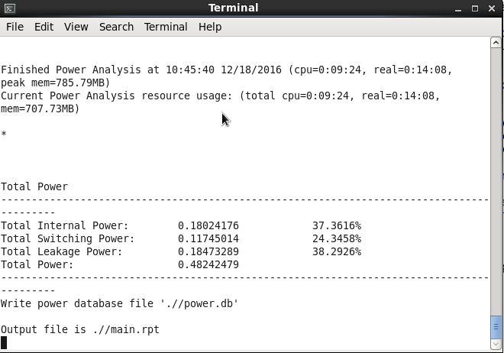
Power

Slide 17
Metrics
Max Speed: 4ns (250 Mhz)
Die Area: 250μm x 250μm = 62,500μm^2
Circuit Density: 88.898%
Power Consumption: 0.482 uW
Figure of Merit: 1.33*10^-7 ns/mW*μm^2
8.30*10^-6 Mhz/mW*μm^2

